Slide 1
Euclidean Distance
حسين علي إبراهيم الشامي

Slide 2
Euclidean Distance
It is defined as the distance between two points. In other words, the Euclidean distance between two points in the Euclidean space is defined as the length of the line segment between two points.

Slide 3

Euclidean Distance’s formula
The formula to measure the distance between two points is:
$$\sqrt{\sum_{1}^{n}{{\left(x_{i}−y_{i}\right)}^{2}}}$$

Slide 4
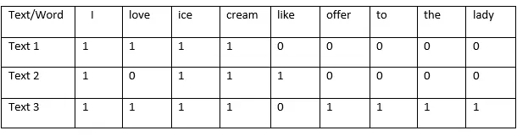
Example
Find the Euclidean distance between Texts 1, 2 and 3:

Slide 5
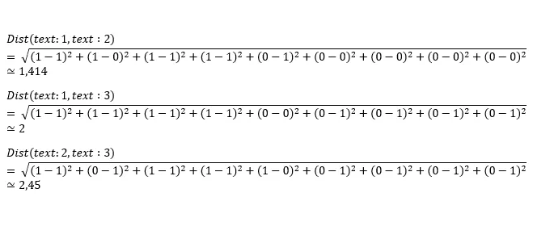
Example
The distance between Text 1 and 2: 1.414
Text 1 and 3: 2
Text 2 and 3: 2.45

Slide 6
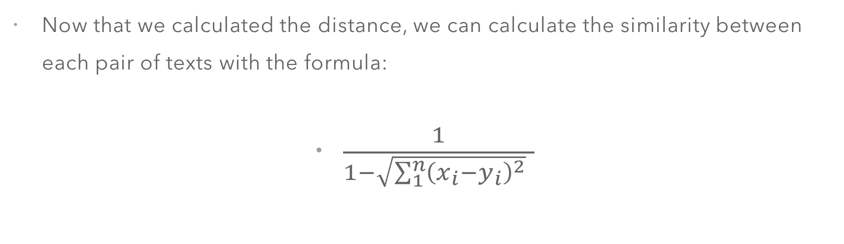
Final Result: Similarity
Now that we calculated the distance, we can calculate the similarity between each pair of texts with the formula:
$\frac{1}{1−\sqrt{\sum_{1}^{n}{{\left(x_{i}−y_{i}\right)}^{2}}} }$

Slide 7
Final Similarity Results
The similarity between each pair is:
Text 1 and 2: 0.41
Text 1 and 3: 0.33
Text 2 and 3: 0.28

